Slide 1
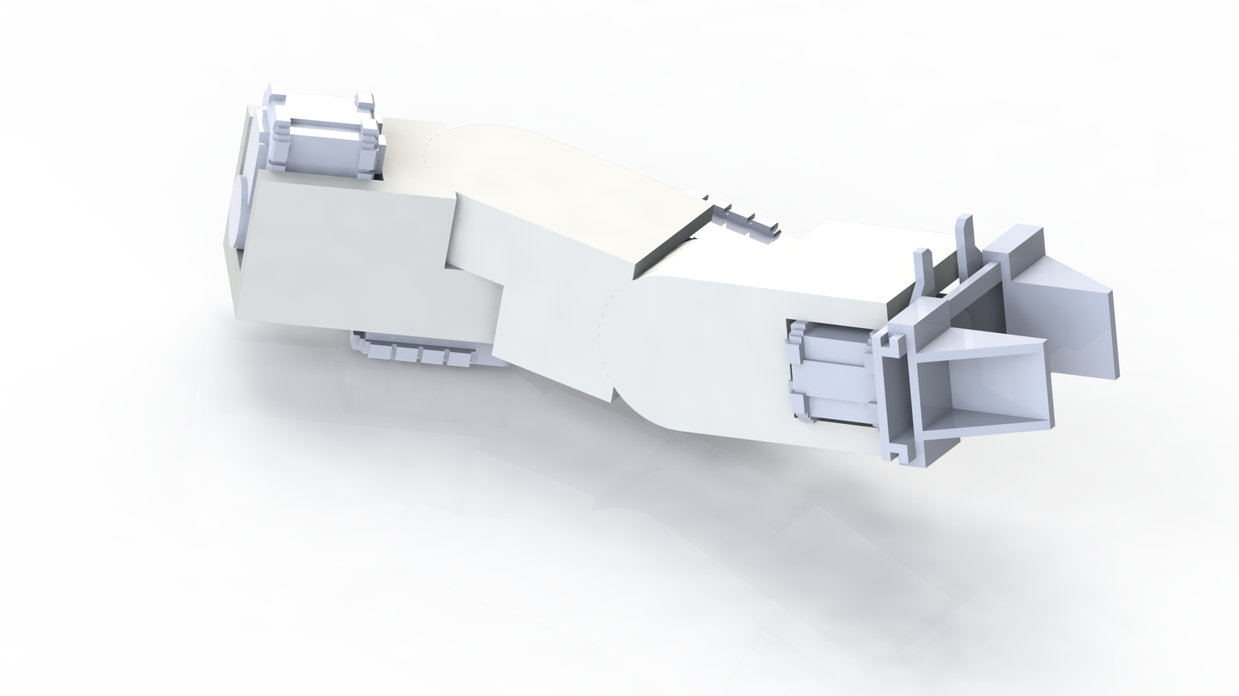

End Effector
Simple parallel gripper
3 Axis servo actuated wrist joint - 2 1200 oz-in servos
- 1 3600 oz-in servo
Potential range of motions
- 360 degrees left/right
- 180+ degrees up/down
- 360 degrees front rotation

Slide 2
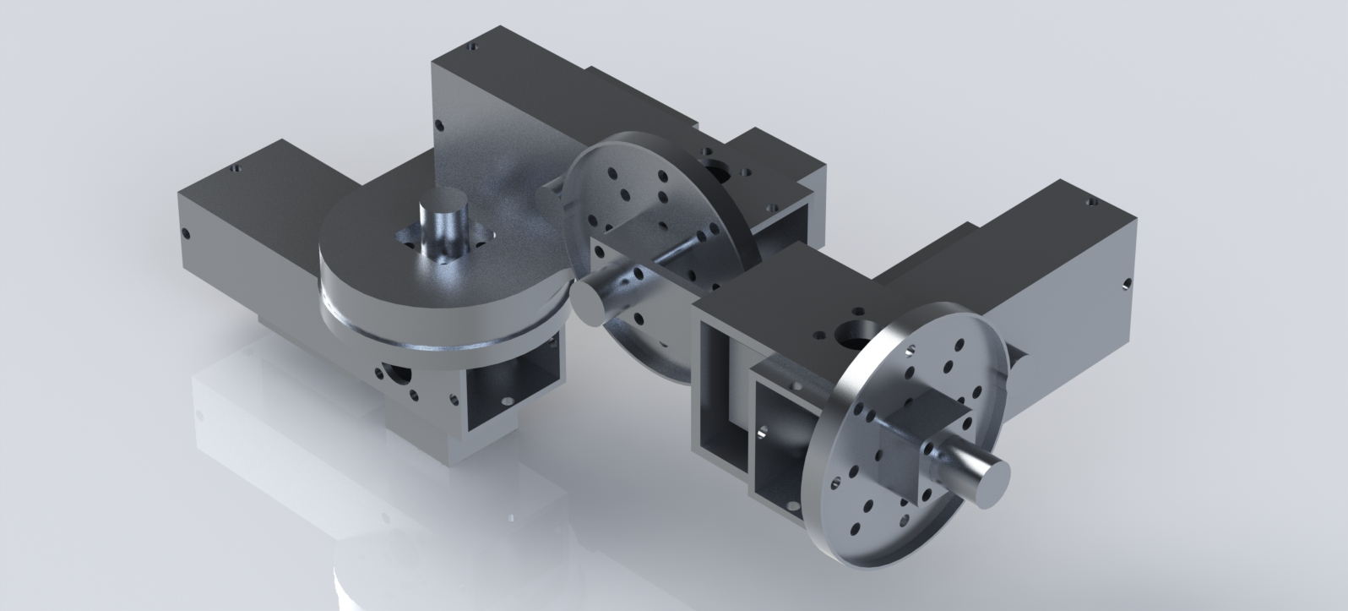
Role of End Effector
Involved with Construction and Soil Sample tasks and now Payload Deployment task
This led to changes in the design
-higher torque servos
-higher mass capacity of gripper
-orientation and length of design

